Slide 1

Data Visualization DSC 465
Second World War Theater of Operations
Presented by The Data Allies
Rakesh Deshalli Ravi
Atta Yaw Agyeman
Harigovind Rajagopal
Sashank Makanoboyina
Sarah Hashmi

Slide 2
INTRODUCTION
The Second World War, spanning from 1939 to 1945
It directly involved more than 100 million people from over 30 countries
It encompasses records of aerial missions carried out by both Allied across different theaters of war
Namely the European Theater of Operations (ETO) and the Pacific Theater of Operations (PTO), among others.

Slide 3
Data Set Overview
Dataset Shape – 178,281 Rows, 56 Columns
Number of Categorical Columns – 19
Number of Numerical Columns – 29
Location Data – 6 Columns have location data in terms of latitude and longitude.
Timeseries Data – 2 Columns
Key Variables
Mission Date
Theater of operations
Country Responsible for the Mission
Aircraft Used
Target Country and Location
Target Type
Tons of Bombs

Slide 4
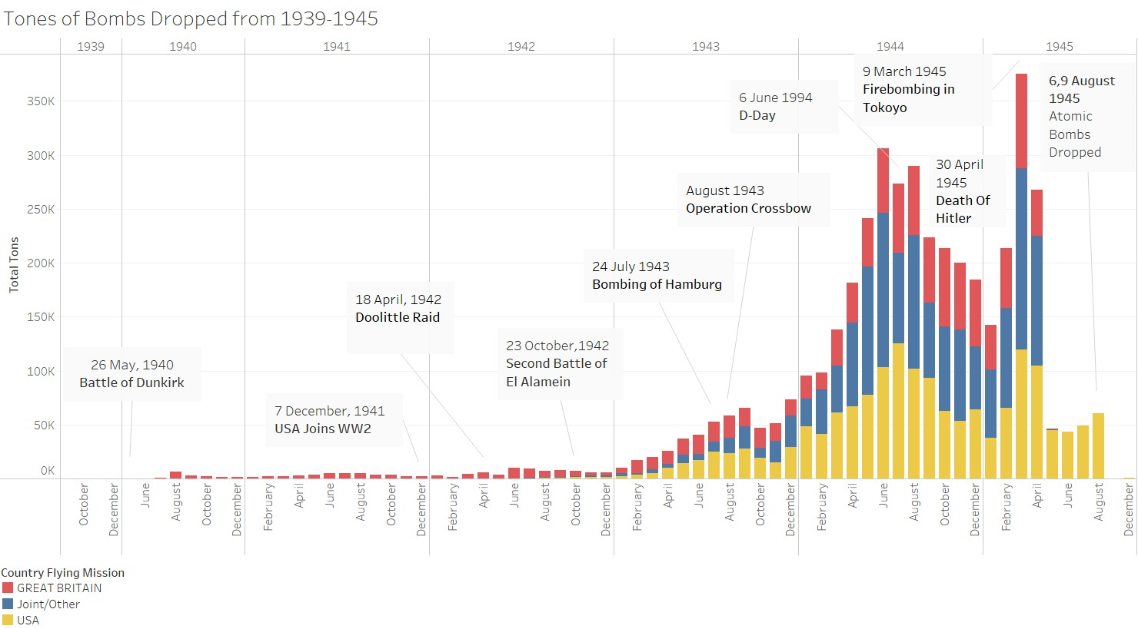
Visualization 1

Slide 5
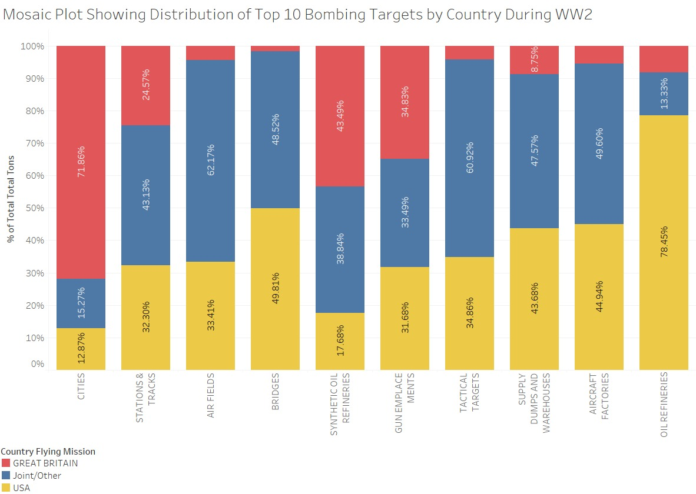
Visualization 2

Slide 6
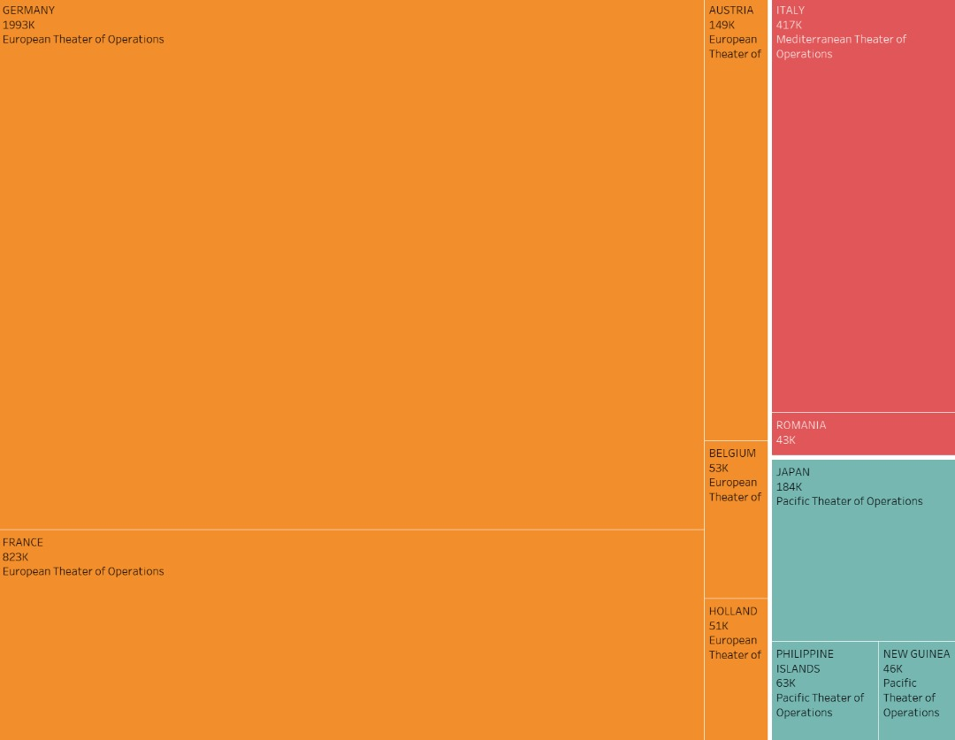
Visualization 3

Slide 7
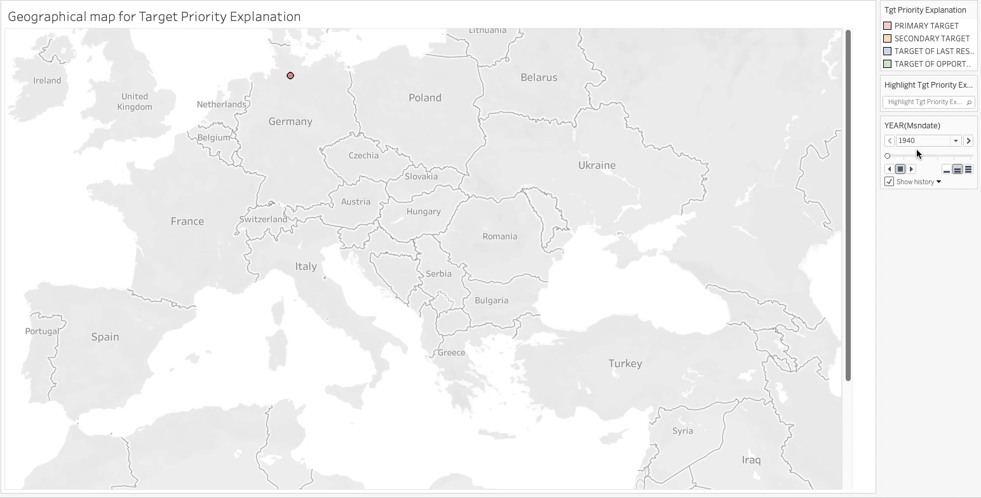
Visualization 4

Slide 8
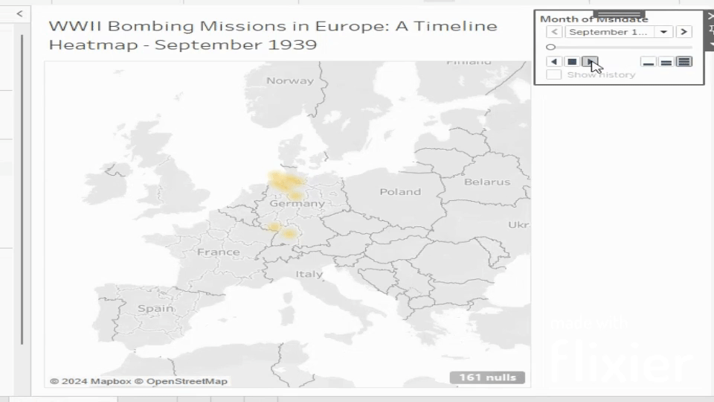
Visualization 5

Slide 9
Thank You

